Slide 1
BINARY TO BCD CONVERTER WITH N BITS
ALBA RUIZ GÓMEZ AND NORMA SCHULZE GIMÉNEZ

Slide 2
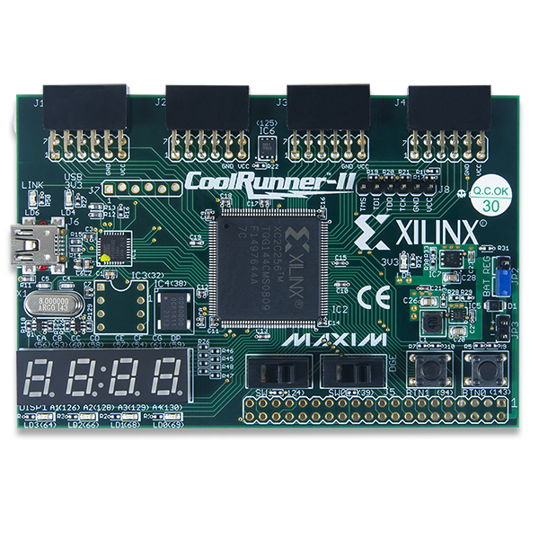
CONTENT
Introduction
Utility of BCD
Theoretical Basis
Instruments used
Connection board
Implementation
Examples
Conclusion

Slide 3
Introduction
Application: 16 bit Binary to 4 digit BCD converter
Objective: Visualization of Binary to BCD converter
Instruments used:
CoolRunner-II CPLD starter board
Expansion switches and LEDs board

Slide 4

Utility of BCD
Electronic systems where numeric values must be shown
Some companies such as IBM used it in their products: IBM1620 and IBM 1400

Slide 5
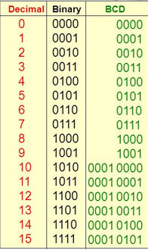
Theoretical basis
BCD: Binary -Coded Binary
Only encodes ten digits from 0 to 9
There are six invalid code words: 1010,
1011, 1100, 1101, 1110, 1111

Slide 6
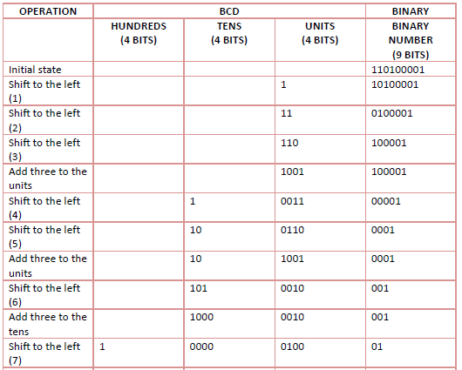
Theoretical basis
Shift the binary number to the left one bit
If some of the digits has a value equal or higher than five, add three
Repeat steps 1 and 2 the amounts of bits that the binary number that we want to convert.

Slide 7
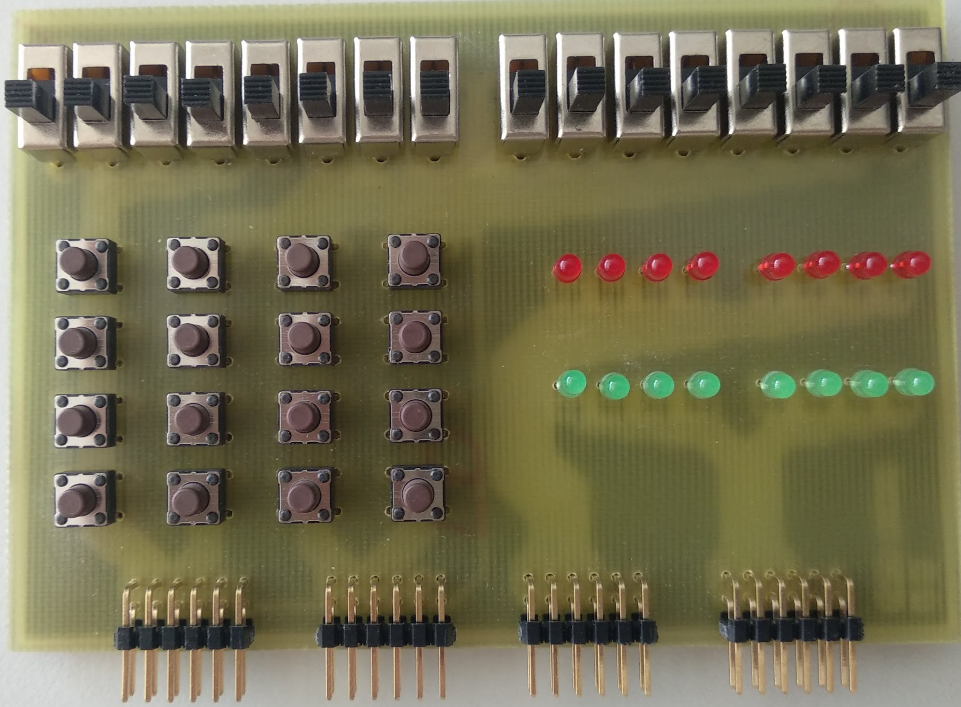
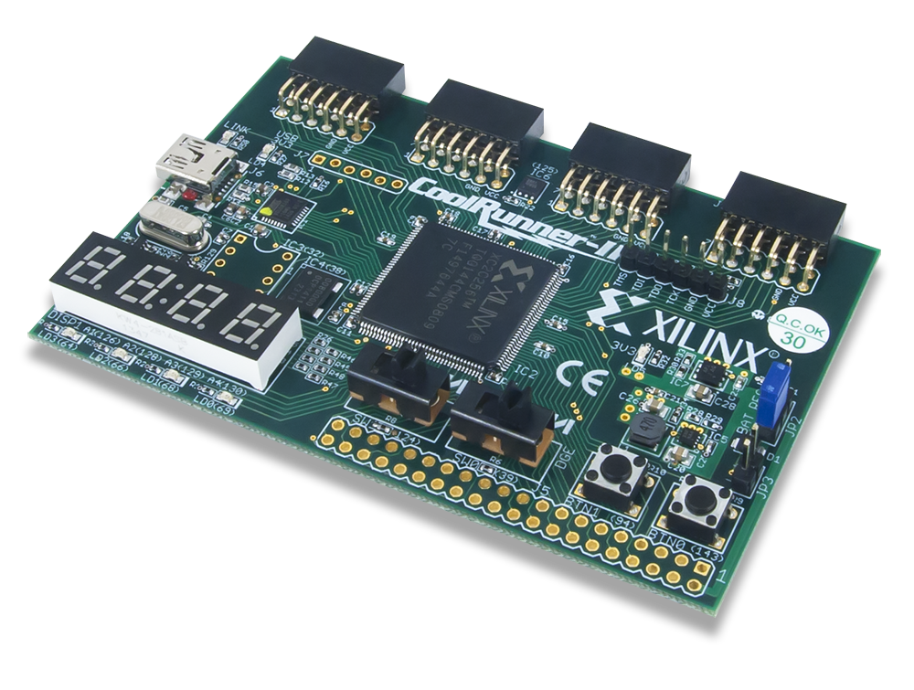
Instruments used
+

Slide 8
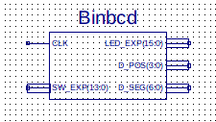
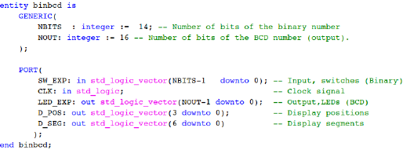
Connection board

Slide 9
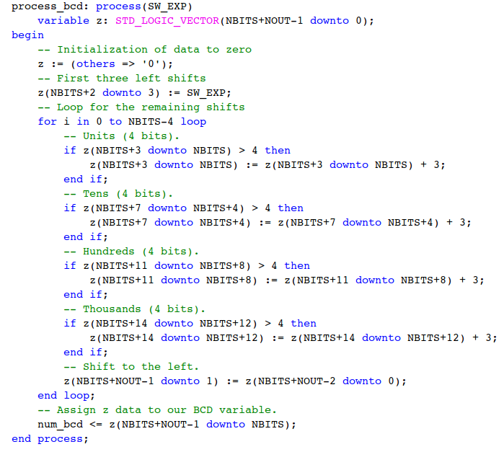

Implementation

Slide 10

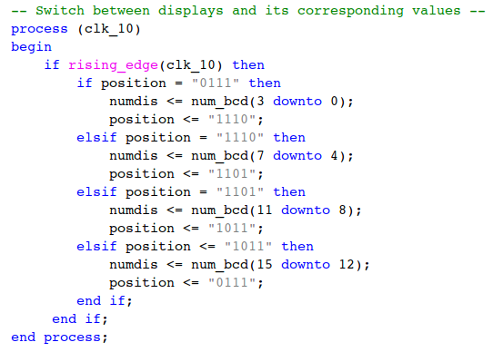
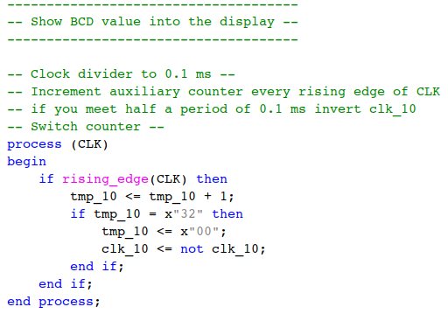
Implementation

Slide 11
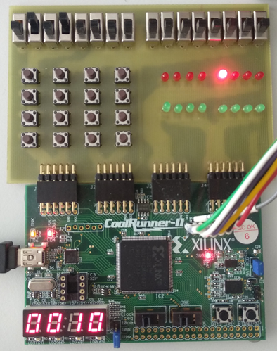
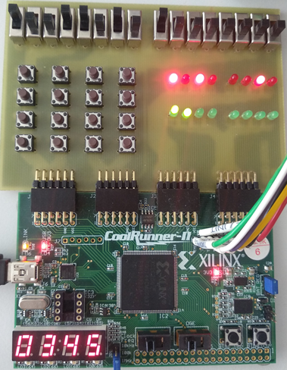
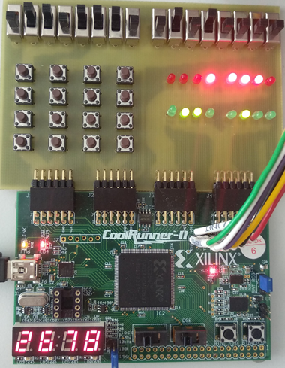
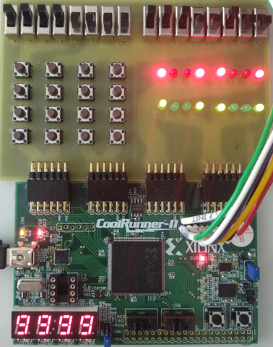
Examples

Slide 12
Conclusion
The manipulation of the numeric data to show becomes easier. This simplify the hardware.
Difficulties:
understanding how the converter works.
choosing the clock to display the value of the 7-segment display.
problems with the device

